Slide 1
QUANTUM
ALGORITHMS

Slide 2
Quantum World: It’s Bizarre!
Superposition
Alive-and-Dead Cat
Collapse
Measurement affects quantum state
Uncertainty
A Theoretical Limitation
Indistinguishability
Non-orthogonal states aren’t fully distinguished
No-Cloning
Arbitrary unknown states cannot be reliably copied
Entanglement
Spooky effect at a distance
Parallelism
Beware of Tensors: Dimensions Multiply!

Slide 3
An Experiment with Photons
The Three Polarizers

Slide 4
The Photon Experiment

Slide 5
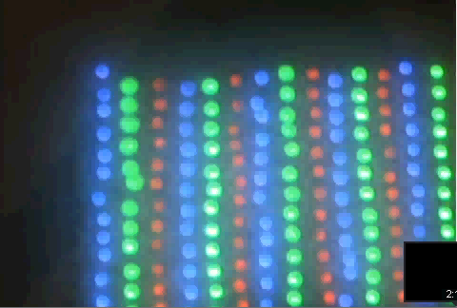
The Photon Experiment (Contd.)

Slide 6
Qubits
An Explanation

Slide 7
Qubits
A quantum bit, or qubit, is a unit vector in a two dimensional complex vector space for which a particular basis has been fixed and is denoted by:
{|0›, |1›}
Qubits can be in a superposition of |0› and |1› such as
a|0› +b |1›
where a and b are complex numbers such that |a|² + |b|² = 1.

Slide 8
Measuring a Qubit in the Basis
For the qubit
a|0› +b |1›
the probability that the measured value is |0› is
|a|²
after which the state collapses to |0› and
the probability that the measured value is |1› is
|b|²
after which the state collapses to |1›

Slide 9
Qubit Model Correctly Predicts the Outcome of Photon Experiment
and several other experiments too!

Slide 10
Quantum Mechanics in a Nutshell
Superposition Postulate
State vector in Hilbert space, Tensor analysis
Measurement & Collapse Postulates
Projections, Inner-products etc.
Evolution Postulate
Schrodinger Equation, Unitary Transformations etc.

Slide 11
No-Cloning Theorem
Assume that U is a unitary transformation that clones, in that U(|a0›) = |aa› for all quantum states |a›.
Consider |c› = (1/√2)(|a› + |b›).
Then,
U(|c0›) = 1/√2 (U(|a0›) + U(|b0›)) = 1/√2(|aa› + |bb›)
But if U is a cloning transformation then
U(|c0›) = |cc› = 1/2(|aa› + |ab› + |ba› + |bb›)
A contradiction.

Slide 12
Multiple Qubits
Individual state spaces of n particles combine classically through the cartesian product.
Quantum states, however, combine through the tensor product.
A basis for a three qubit system is
{|000›, |001›, |010›, |011›, |100›, |101›, |110›, |111›}
and in general an n qubit system has 2^{n} basis vectors.
We can now see the exponential growth of the state space with the number of quantum particles.

Slide 13
Quantum Entanglement
The state |00› +|11› cannot be described in terms of its components (qubits) separately.
We cannot find a₁, a₂, b₁, b₂ such that
(a₁|0› + b₁|1›) ⊗ (a₂|0› + b₂|1›) = |00› + |11›
= a₁a₂|00› + a₁b₂|01› + b₁a₂|10› + b₁b₂|11›
Means a₁b₂ = 0 which implies that either a₁a₂ = 0 or b₁b₂ = 0.
States which cannot be decomposed in this way are called entangled states.

Slide 14
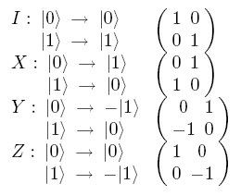
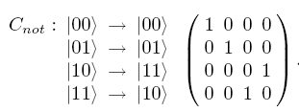

Quantum Gates and Circuits
Five Simple Quantum Gates and C_{not} gate

Slide 15
Quantum Teleportation
The objective is to transmit the quantum state of a particle using classical bits and reconstruct the exact quantum state at the receiver.
Does not contradict no-cloning theorem

Slide 16
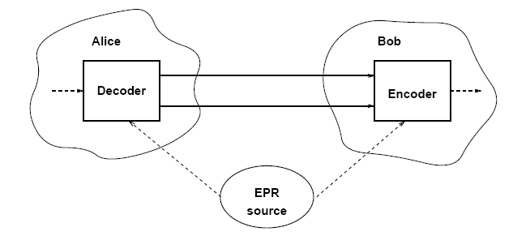
Quantum Teleportation (Contd.): The Setting
Alice has a qubit whose state she doesn’t know. She wants to send the state of this qubit
φ = a|0› + b|1›
to Bob through classical channels.
Alice and Bob each possess one qubit of an entangled pair
ψ₀ = 1/√2(|00› + |11›)

Slide 17
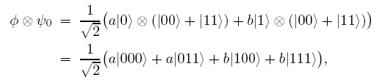
Quantum Teleportation (Contd.)
Initial state is
of which Alice controls the first two bits and Bob controls the last one.

Slide 18
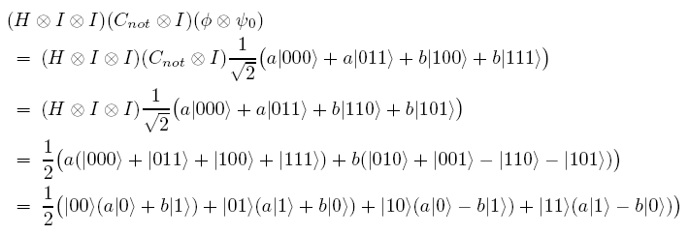
Quantum Teleportation (Contd.)
Alice now applies

Slide 19
Quantum Teleportation (Contd.)
Alice measures the first two qubits
She obtains one of the four outputs with equal probability. Alice sends the result of her measurement as two classical bits to Bob
Alice’s Output | Modified Bob’s Qubit

Slide 20
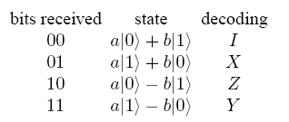
Quantum Teleportation (Contd.)
When Bob receives the two classical bits from Alice he knows how the state of his half of the entangled pair compares to the original state of Alice’s qubit.
Bob can reconstruct the original state of Alice’s qubit, φ, by applying the appropriate decoding transformation to his part of the entangled pair as follows:

Slide 21
THANK YOU Any Questions?
SUMMARY:
Three polarizers experiment
Qubits
Postulates of Quantum Mechanics
No-Cloning Theorem
Quantum Teleportation

